Slide 1
Unit V- SPREAD SPECTRUM AND MULTIPLE ACCESS
Spread spectrum

Slide 2
Session Objectives
Introduce the concept of Spread spectrum
Notes:
Student Notes:
The objective of the session is to introduce the concept of Spread spectrum
.

Slide 3
Session Outcomes
At the end of this session, participants will be able to
Understand the concept of Spread spectrum modulation
.
Notes:
Student Notes:
At the end of this session, you will have an understanding of cyclic codes

Slide 4
Agenda
Spread Spectrum
PN Sequence
Direct Sequence Spread Spectrum
Frequency Hopped Spread Spectrum

Slide 5
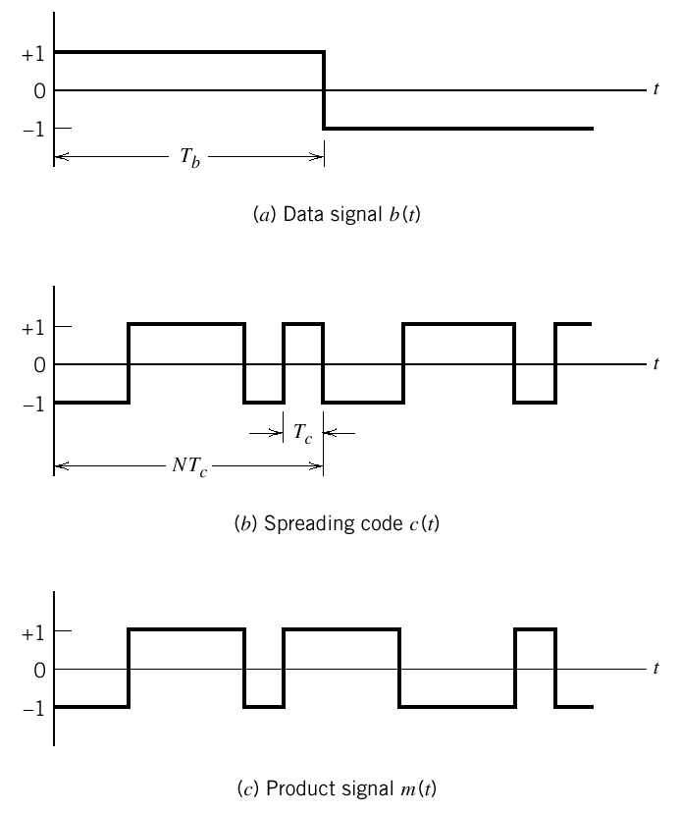
Spread Spectrum- Main Operation
b(t)
m(t)
x
c(t)
B(f)
M(f)

Slide 6
Spread Spectrum: Main Operation
m(t)
r(t)
u(t)
+
x
j(t)
c(t)
c(t) alternates between +1 and -1
Therefore c²(t) is always +1

Slide 7
Spread Spectrum
Wideband Modulation
Benefits
Information Security
Interference Resistance
Band Sharing
Frequency Hopping Spread Spectrum (FHSS)
Data are constant
Frequencies are randomized
Direct Sequence Spread Spectrum (DSSS)
Frequency is constant
Data are randomized
immunity from noise and multipath distortion
can hide / encrypt signals
several users can share same higher bandwidth with little interference
CDM/CDMA Mobile telephones
Notes:
Spread spectrum technology has blossomed from a military technology into one of the fundamental building blocks in current and next-generation wireless systems. From cellular to cordless to wireless LAN (WLAN) systems, spectrum is a vital component in the system design process.

Slide 8
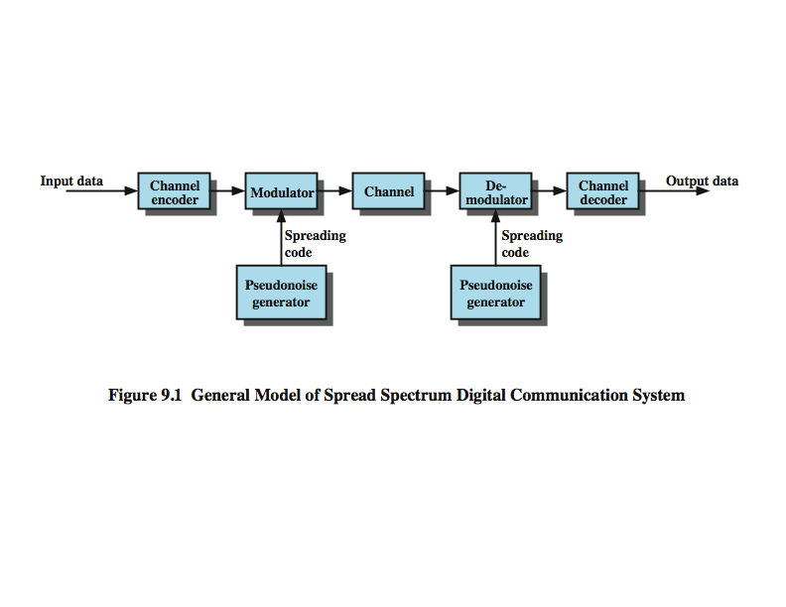
General Model of Spread Spectrum System

Slide 9
Pseudo random Sequences
The spread of the “random” sequence of frequencies is determined by a pseudo noise (PN) sequence generator.
A PN generator outputs a stream of bits (1s and 0s) that appears random (has no apparent pattern).
PN sequence generators are easy to construct using simple logic components:
XOR gates, and
a shift register, made up of flip flops
A PN sequence is not truly random (hence, “pseudo”), but is periodic and repeats at a fixed interval.

Slide 10
Pseudorandom Numbers
Generated by a deterministic algorithm
not actually random
but if algorithm good, results pass reasonable tests of randomness
Starting from an initial seed
Need to know algorithm and seed to predict sequence
Hence only receiver can decode signal

Slide 11
PN Sequence Generator
The PN sequence length is the number of iterations (the number of 1s and 0s) before the sequence repeats.
The sequence length is determined by the:
number of flip flops, n, in the shift register
selection of feedback taps that are applied to one or more XOR gates.
The sequence length can have a maximum value of:
A PN sequence that has this length is said to be a maximal length sequence.
number of flip flops

Slide 12
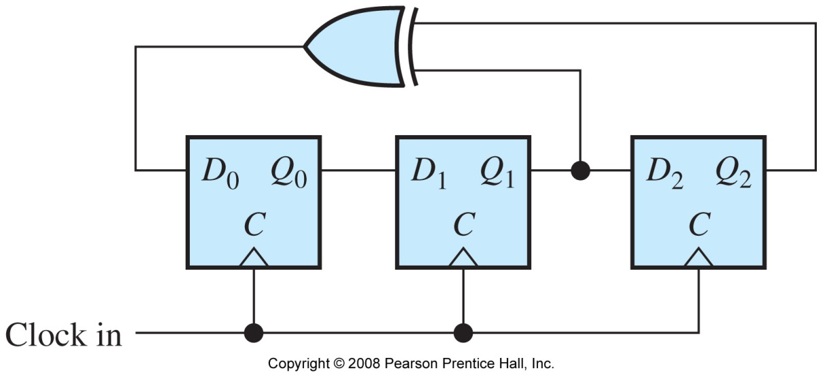
PN Sequence Generator
For the PN sequence generator below, the number of flip flops, n, is 3.
This generator will generate a maximal length sequence, and the length is determined by:
maximum length = 7

Slide 13
Properties of PN Sequence
Randomness
Uniform distribution
Balance property- In each period of a maximal length sequence, the number of 1s is always one more than the number of 0s
Run property
Independence
Correlation property
Unpredictability

Slide 14
PN Sequence
Period of m-sequence is N=2^{m}-1
If T_{c} is the time per bit in the m-sequence
then define T_{b}=NT_{c}
After T_{b} seconds the PN sequence repeats

Slide 15
Properties of m-sequences
Property 1:
Has 2^{n-1} ones and 2^{n-1}-1 zeros
Property 2:
For a window of length n slid along output for N (=2^{n-1}) shifts, each n-tuple appears once, except for the all zeros sequence
Property 3:
Sequence contains one run of ones, length n
One run of zeros, length n-1
One run of ones and one run of zeros, length n-2
Two runs of ones and two runs of zeros, length n-3
2^{n-3} runs of ones and 2^{n-3} runs of zeros, length 1

Slide 16
Direct Sequence Spread Spectrum (DSSS)
Each bit represented by multiple bits using spreading code
Spreading code spreads signal across wider frequency band
In proportion to number of bits used
10 bit spreading code spreads signal across 10 times bandwidth of 1 bit code
One method:
Combine input with spreading code using XOR
Input bit 1 inverts spreading code bit
Input zero bit doesn’t alter spreading code bit
Data rate equal to original spreading code
Performance similar to FHSS

Slide 17
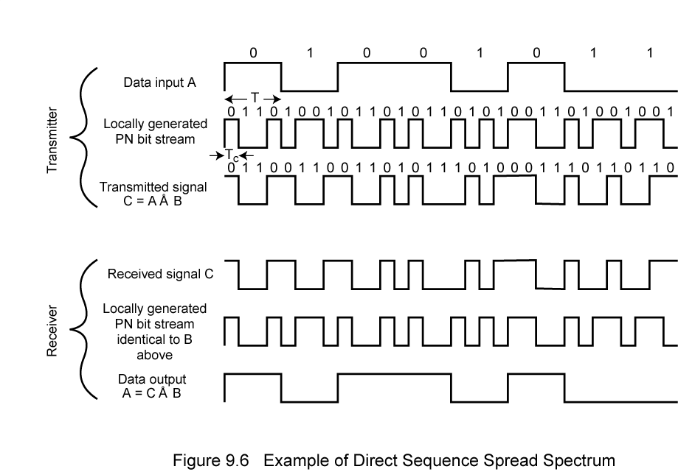
Direct Sequence Spread Spectrum Example

Slide 18
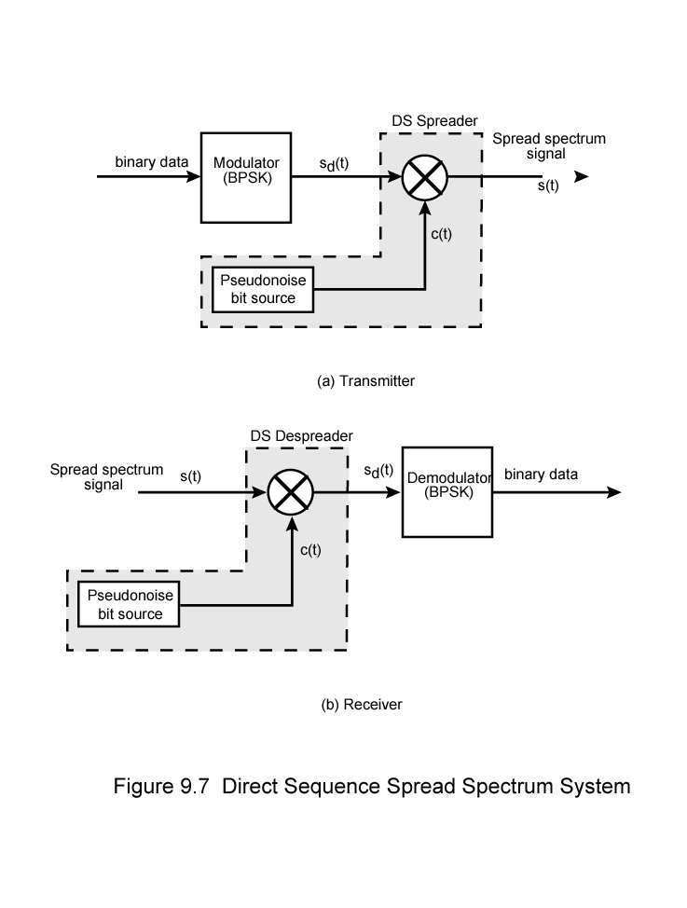
Direct Sequence Spread Spectrum Transmitter

Slide 19
Direct Sequence Spread Spectrum Transmitter

Slide 20
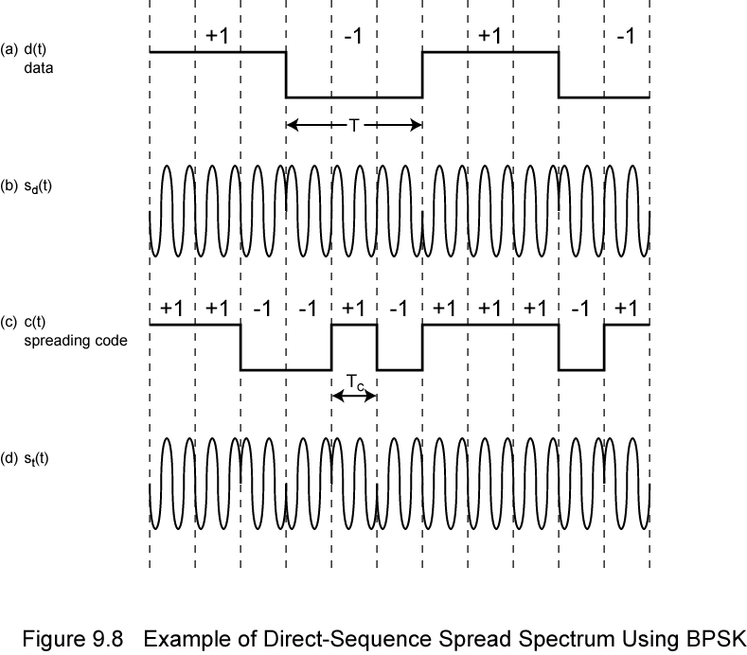
Direct Sequence Spread Spectrum Using BPSK Example

Slide 21
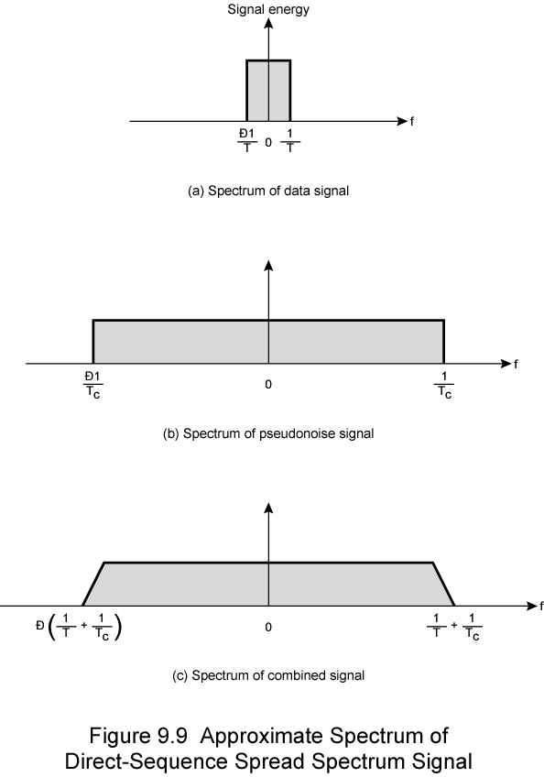
Approximate Spectrum of DSSS Signal

Slide 22
Processing Gain and Jamming margin
It is the ratio of spread bandwidth to unspread bandwidth. It is expressed in dB
For example, if a 1 kHz signal is spread to 100 kHz, the process gain expressed as a numerical ratio would be100000/1000 = 100.
= 10log₁₀100 dB
Jamming margin : The level of interference (jamming) that a system is able to accept and still maintain a specified level of performance.

Slide 23
Frequency Hopping Spread Spectrum (FHSS)
Signal broadcast over seemingly random series of frequencies
Receiver hops between frequencies in sync with transmitter
Eavesdroppers hear unintelligible blips
Jamming on one frequency affects only a few bits

Slide 24
Basic Operation
Typically 2^{k} carriers frequencies forming 2^{k} channels
Channel spacing corresponds with bandwidth of input
Each channel used for fixed interval
300 ms in IEEE 802.11
Some number of bits transmitted using some encoding scheme
May be fractions of bit (see later)
Sequence dictated by spreading code

Slide 25
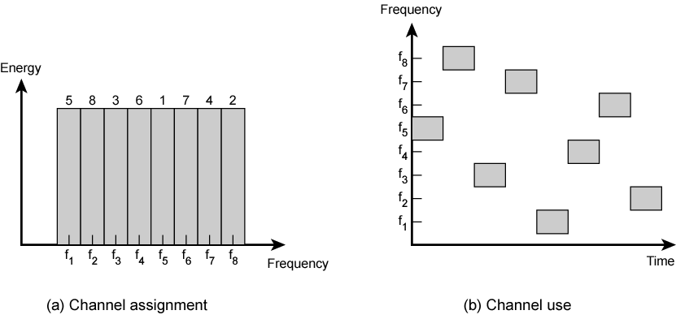
Frequency Hopping Example

Slide 26
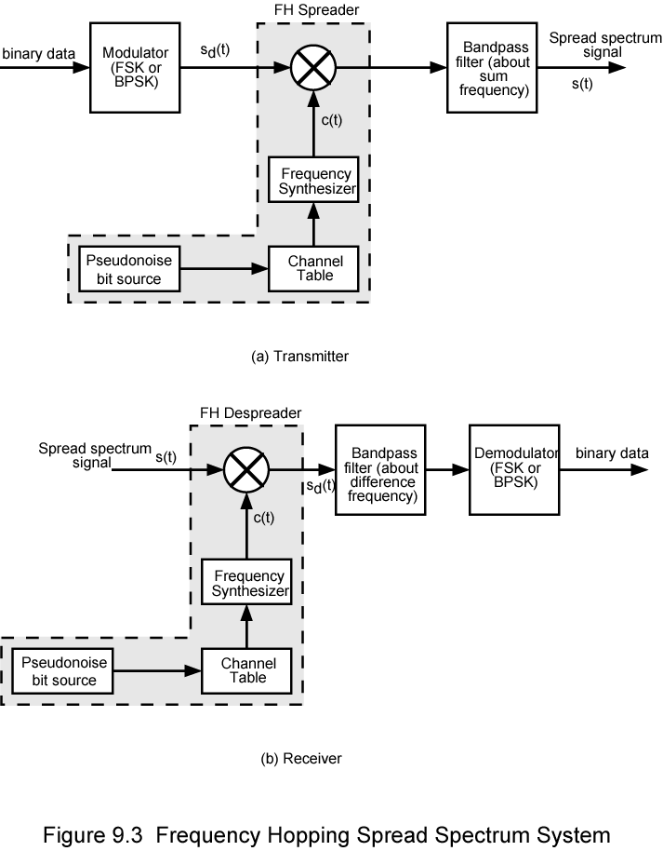
Frequency Hopping Spread Spectrum System (Transmitter)

Slide 27
Frequency Hopping Spread Spectrum System (Receiver)

Slide 28
Slow and Fast FHSS
Frequency shifted every T_{c} seconds
Duration of signal element is T_{s} seconds
Slow FHSS has T_{c} ≥ T_{s}
Fast FHSS has T_{c} < T_{s}
Generally fast FHSS gives improved performance in noise (or jamming)

Slide 29
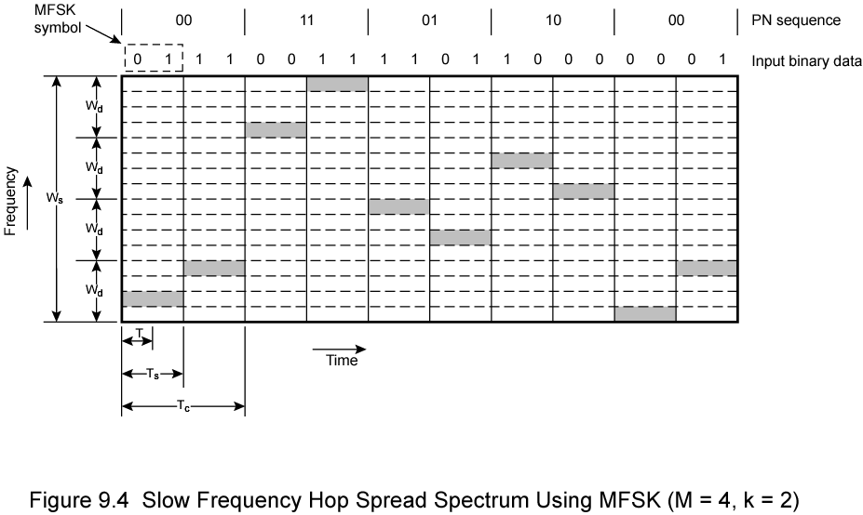
Slow Frequency Hop Spread Spectrum Using MFSK (M=4, k=2)

Slide 30
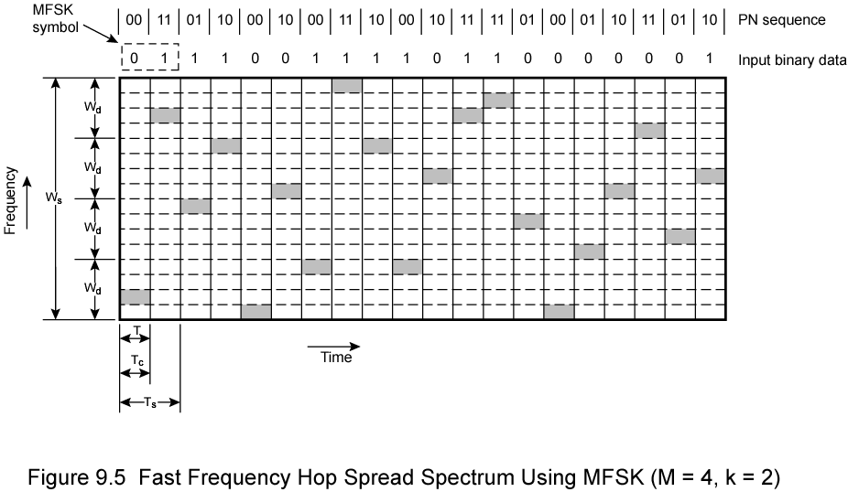
Fast Frequency Hop Spread Spectrum Using MFSK (M=4, k=2)

Slide 31
FHSS Performance Considerations
Typically large number of frequencies used
Improved resistance to jamming

Slide 32
Summary
PN Sequence
Direct Sequence Spread Spectrum
Frequency Hopped Spread Spectrum

Slide 33
Test your understanding
Define DSS?
What is a PN Sequence?
What are the properties of PN sequence
Define FHSS.
Advantages of FHSS

Slide 34
References
H Taub, D L Schilling, G Saha, “Principles of Communication Systems” 3/e, TMH 2007
. S. Haykin “Digital Communications” John Wiley 2005

